Slide 1
History of Computer Science
CPSC-298-06
Interterm 2021
Elia Eiroa Lledo

Slide 2
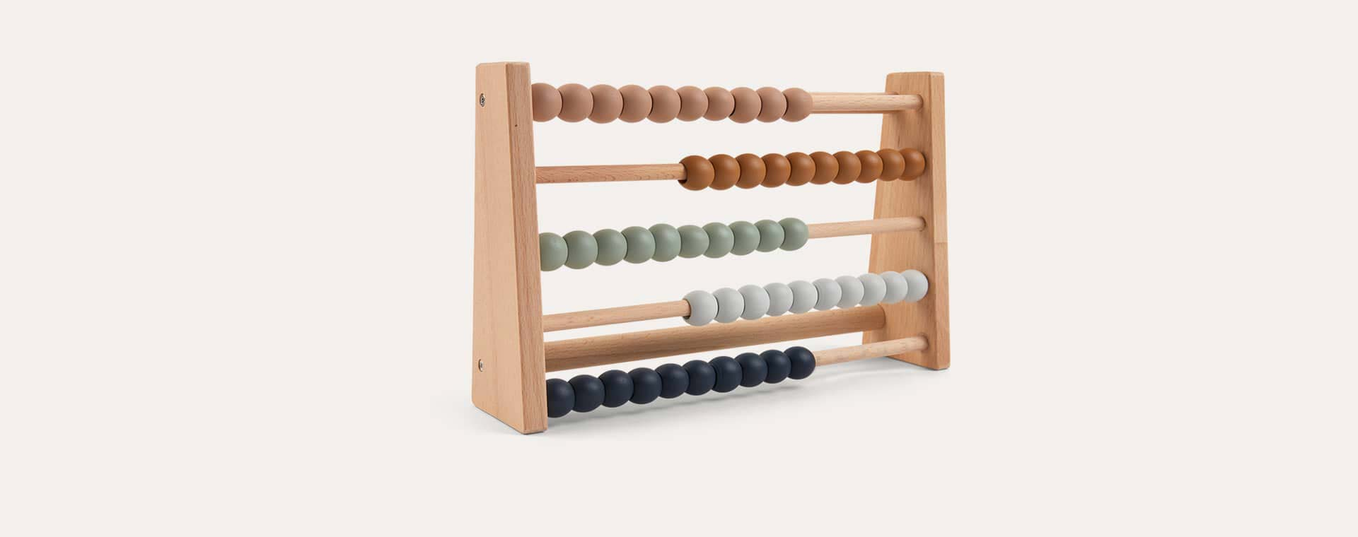
The Abacus
Earliest device to aid in computation
Invented in Mesopotamia around 2500 BCE / 1200 C.E. in China
Calculator to add and subtract
Stores the current state of the computation, just like hard drives do today

Slide 3
Other Computing Devices
More computing devices were created over then next 4000 years
For example, the astrolabe invented in Greece by Hipparchus that was used to calculate longitude and latitude in ships
These devices were very specific and were mostly only used for one purpose

Slide 4
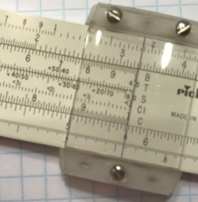
The Slide Rule
Photo credits: Mirko Tobias Schäfer
The slide rule, or Slipstick, was used for assisting with multiplication and division
Invented by William Oughtred in England in the 1600s based on John Napier's discovery of logarithms.

Slide 5
The Calculator
Blaise Pascal’s machine, La Pascaline, could add and subtract but never became popular

Slide 6
I haue read the truest computer of Times, and the best Arithmetician that euer breathed, and he reduceth thy dayes into a short number.
“
”
Richard Braithwaite, 1613
First use of the word ”computer”, referred to a person making calculations.

Slide 7
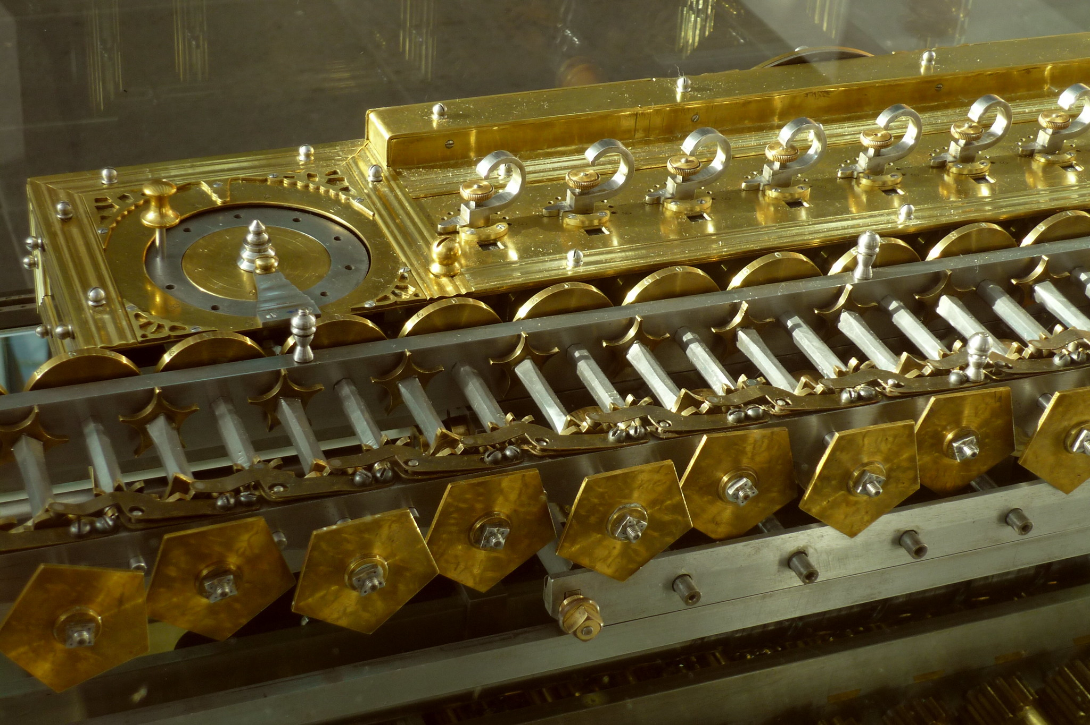
The Step Reckoner
Photo credits: Mirko Tobias Schäfer
Built by German polymath Gottfried Wilhelm Leibniz
“it is beneath the dignity of excellent men to waste their time in calculation when any peasant could do the work just as accurately with the aid of a machine.”
– Leibniz, 1685

Slide 8
The Step Reckoner
Calculations were carried out by “human computers”

Slide 9
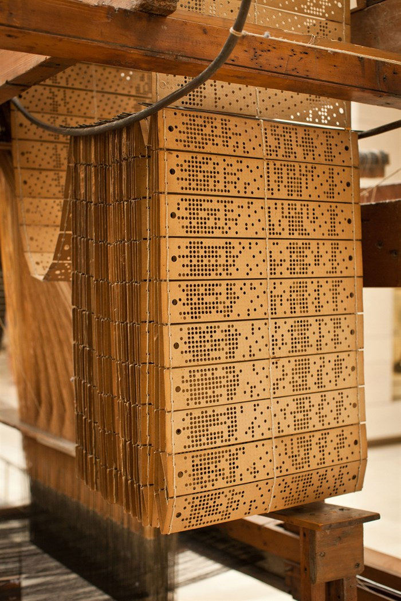
Punch Card System by J.M. Jaquard - 1801
The Loom
The Punch Cards

Slide 10

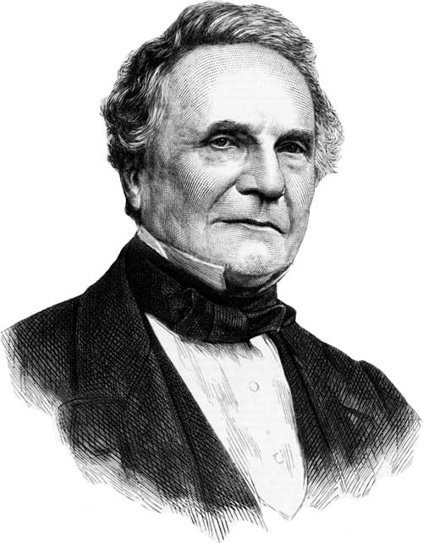
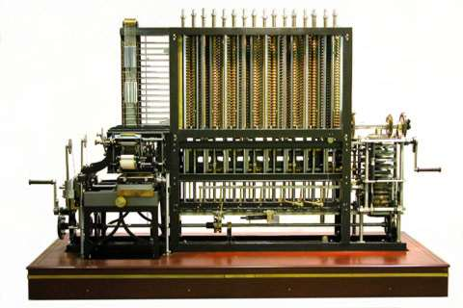
Computation in the Battlefield
Range Tables
The Difference Engine

Slide 11
The Analytical Engine
A general purpose computer
Way ahead of its time so it was never actually built
Babbage is known as “the father of computing”

Slide 12
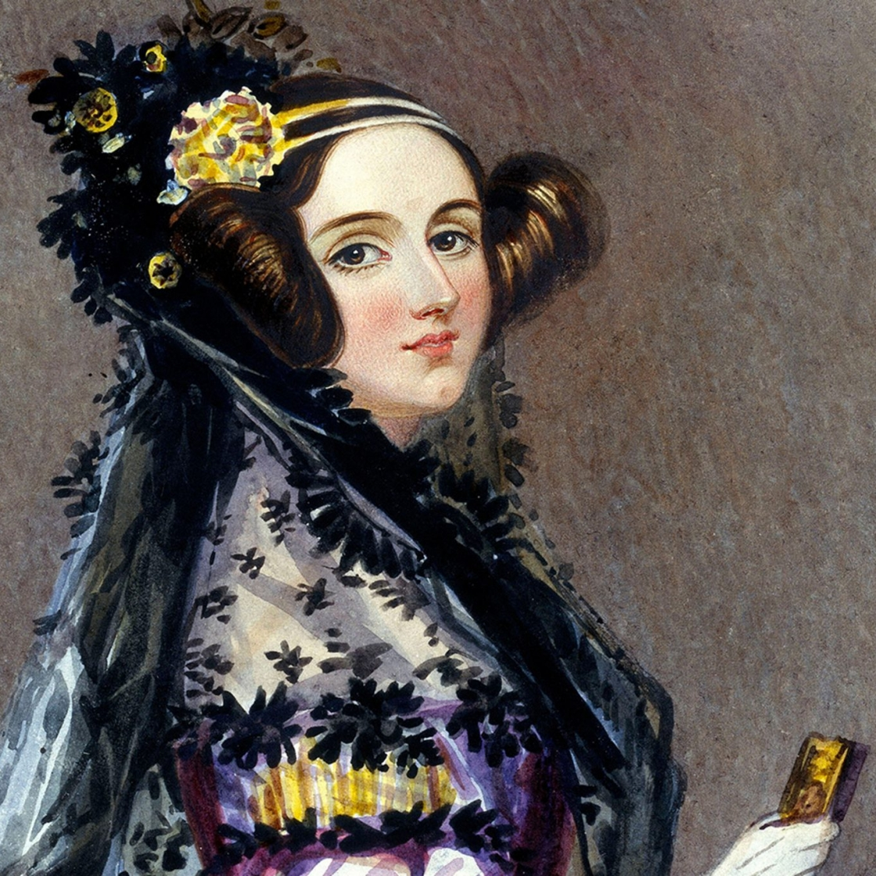
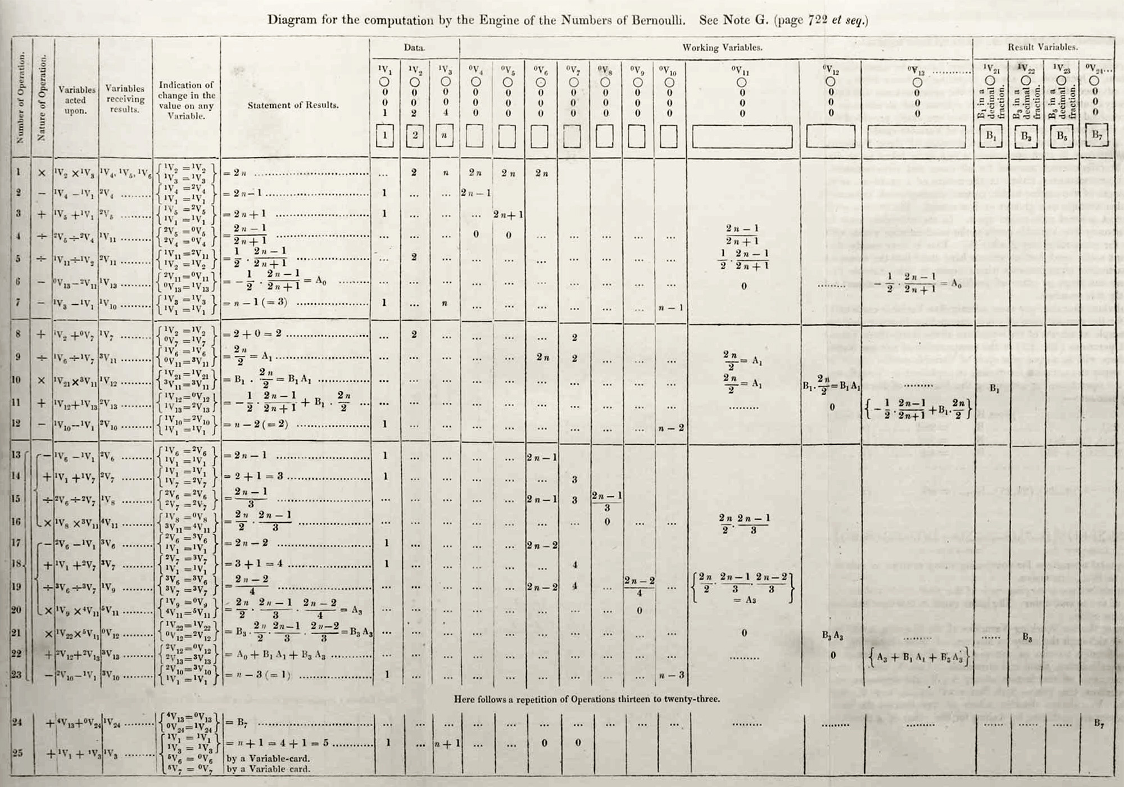
Ada Lovelace – First Ever Computer Programmer
Column Header 1
Column Header 2

Slide 13
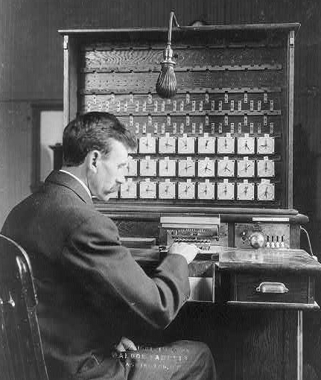
The U.S. Census and Herman Hollerith
The U.S. Constitution calls for a census every 10 years
This task became too hard to do manually because of the growing population of the country
Hired Herman Hollerith who built an “electro-mechanical” tabulating system

Slide 14
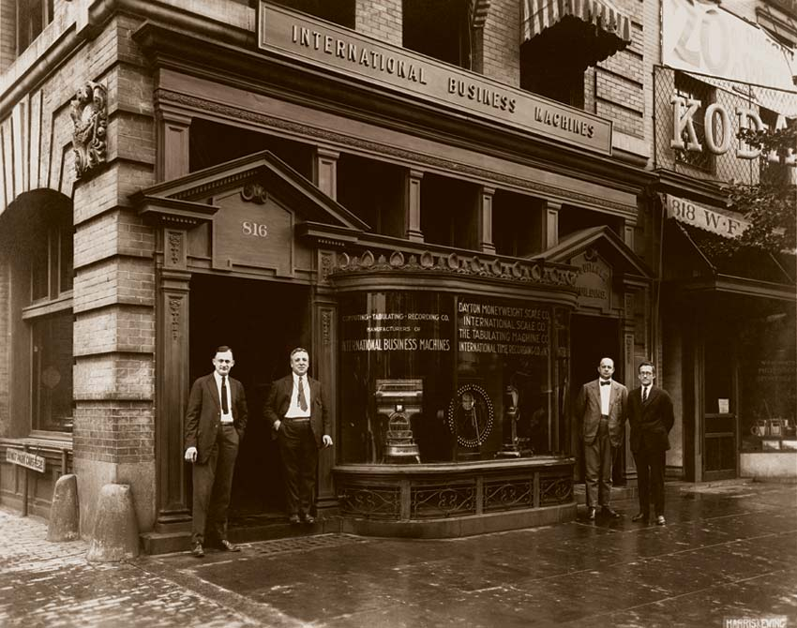
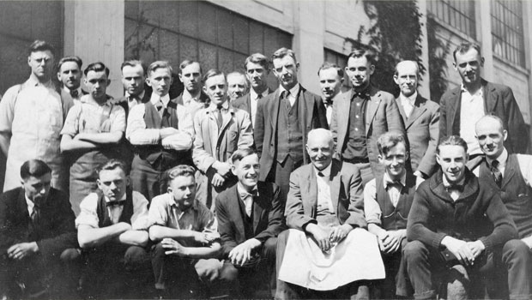
The Formation of IBM
The Endicott, NY, toolmakers group, circa 1917
A 1924 storefront for IBM

Slide 15
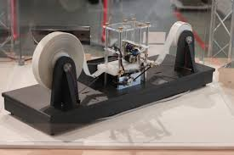
Alan Turing (father of computer science)
in 1936, Alan Turing developed the theory for "Turing machines”, a hypothetical machine that can simulate any computer algorithm, no matter how complicated it is!
It works with an infinitely-long tape which acts like the memory. The tape has squares that are usually blank at the start and can be written with symbols, usually 1, 0, or blank

Slide 16
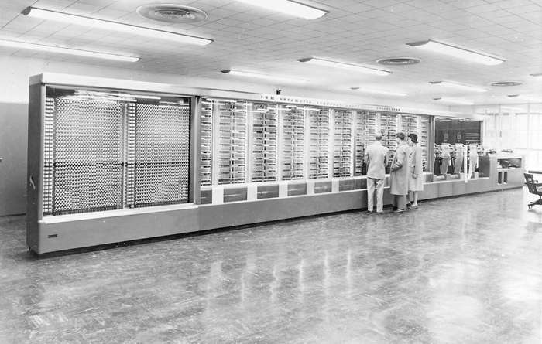
The Harvard Mark I
Completed in 1944 by IBM for the Allies during World War
Could do 3 additions or subtractions per second; multiplications took 6 seconds, and divisions took 15. More complex operations, like a trigonometric function, could take over a minute.
Had important limitations
Designed by Howard Aiken, this electromechanical computer, more than 50 feet (15 metres) long and containing some 750,000 components, was used to make ballistics calculations during World War II.
IBM Archives

Slide 17
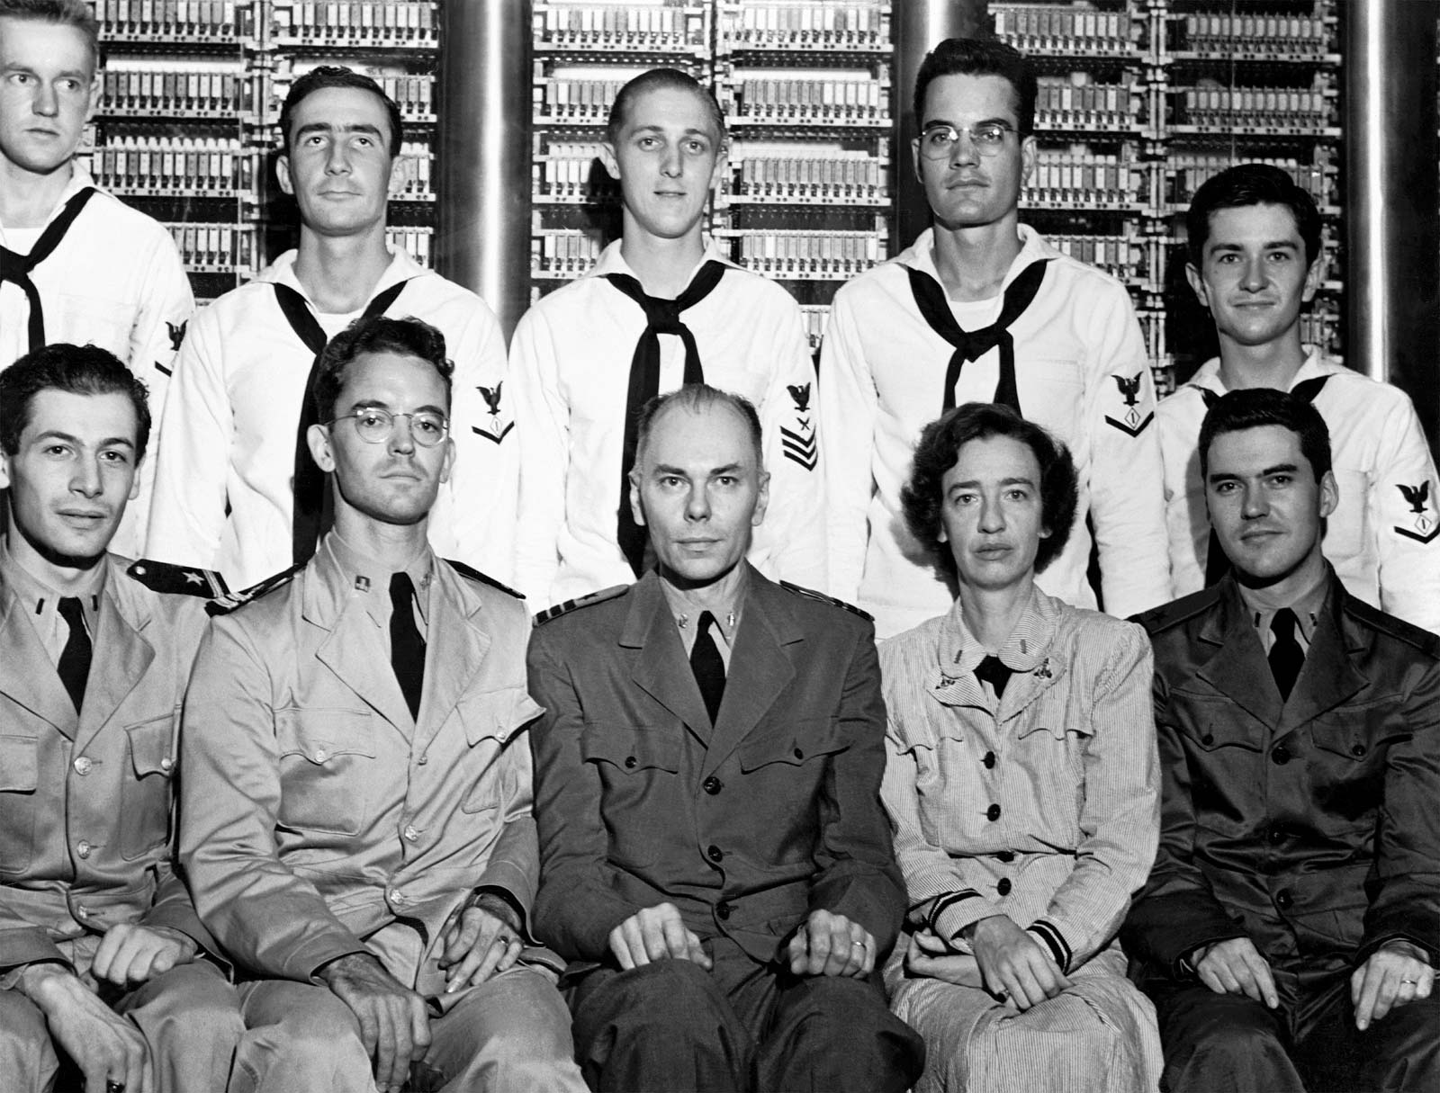
Limitations
Slow switching speed
Wear and tear
Attracted bugs… this is where the term “computer bug” came from (:
“From then on, when anything went wrong with a computer, we said it had bugs in it.” – Grace Murray Hopper
Grace Murray Hopper and Howard Aiken, along with other members of the Bureau of Ordnance Computation Project, in front of the Harvard Mark I computer at Harvard University, 1944. U.S. Department of Defense

Slide 18
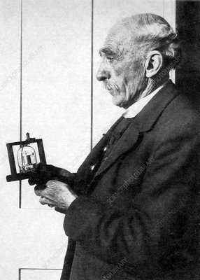
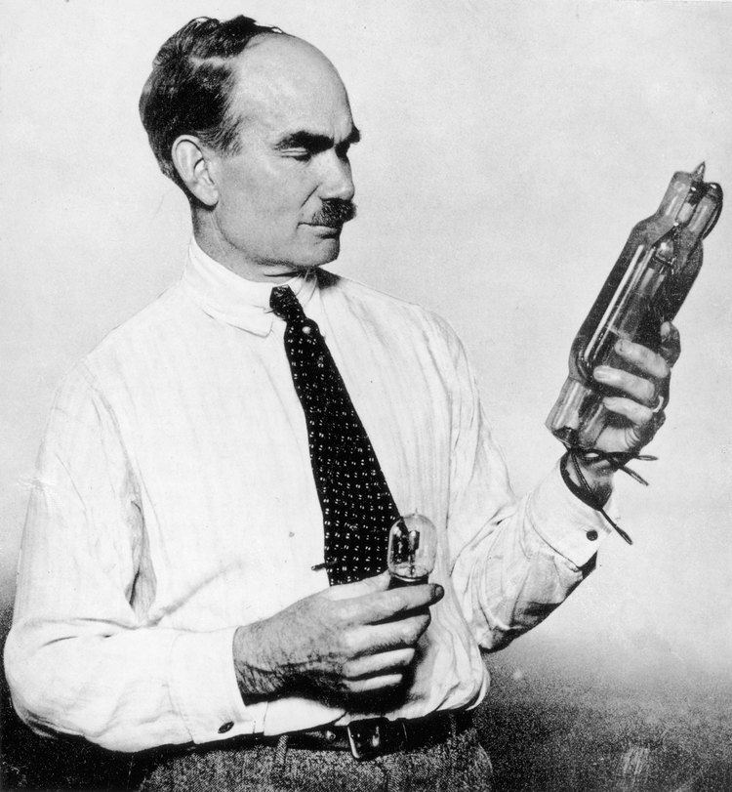
The Thermionic Valve
In 1904, English physicist John Ambrose Fleming developed the thermionic valve – first vacuum tube
In 1906 Lee de Forest added a third “control” electrode that sits between the two electrodes in Fleming’s design
Also had some limitations – fragile & expensive
John Ambrose Fleming Lee de Forest

Slide 19
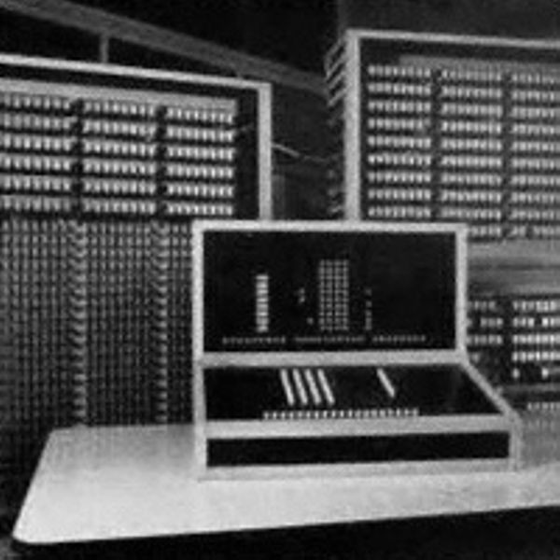
Z3 Machine
Designed by Konrad Zuse in 1935, completed in Berlin in 1941
The first program-controlled electromechanical digital computer
Program code was stored on punched film. Initial values were entered manually

Slide 20
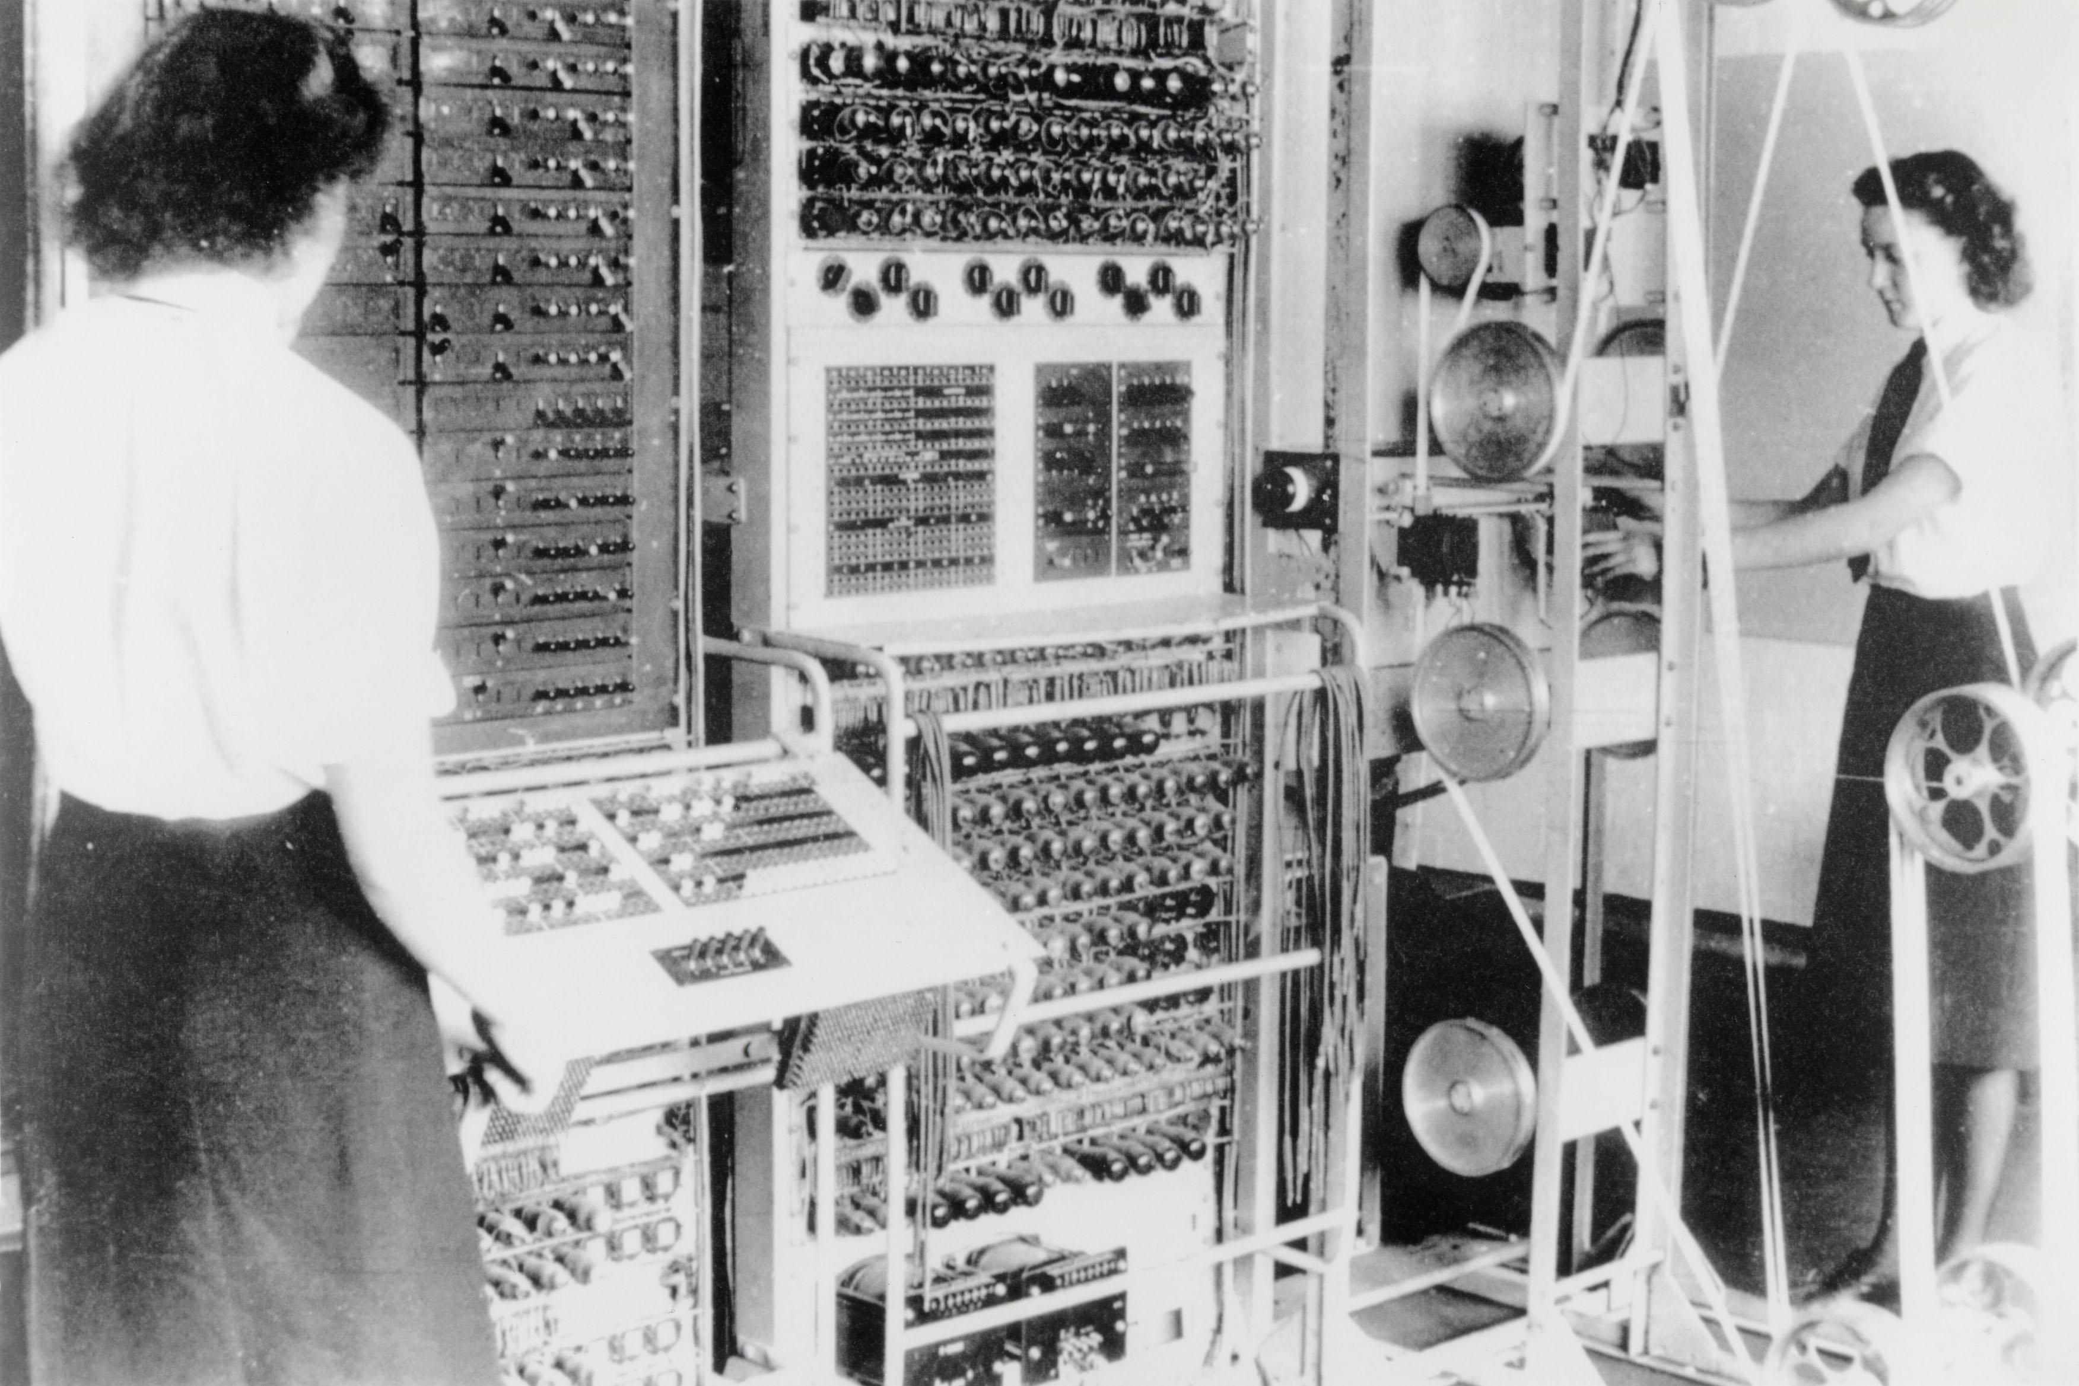
The Colossus
Designed by Tommy Flowers and completed in December of 1943 at Bletchley Park
It was the first large-scale use of vacuum tubes for computing
Helped to decrypt Nazi communications
The first programmable, electronic computer
The machine’s existence was not made public until the 1970s

Slide 21
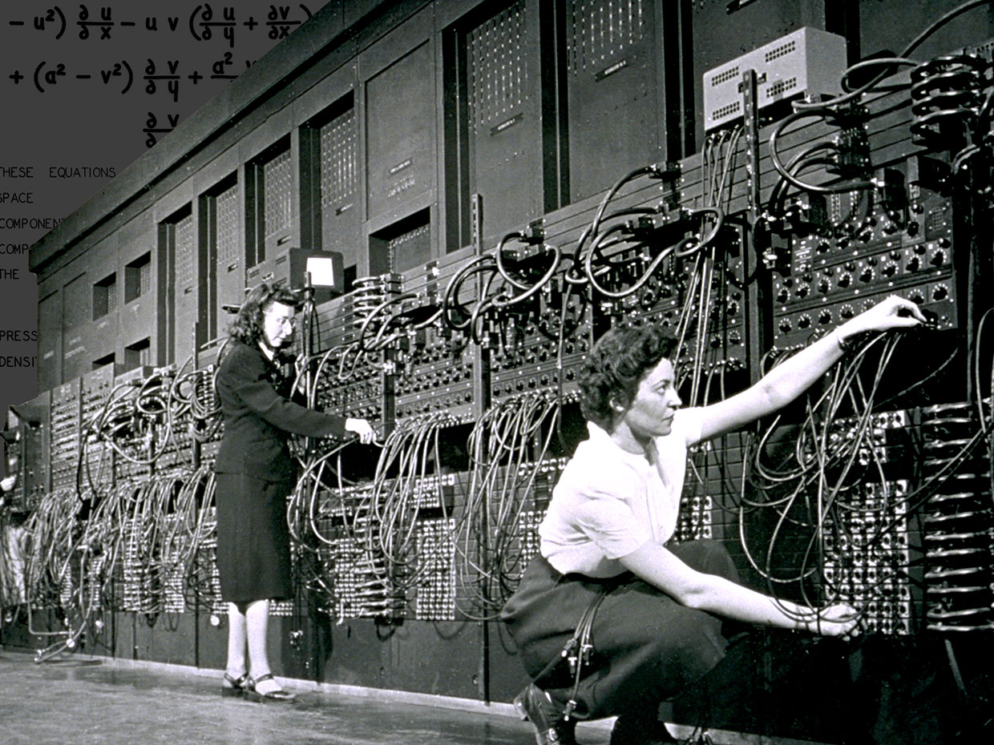
The Electronic Numerical Integrator and Calculator (ENIAC)
1946, University of Pennsylvania.
Designed by John Mauchly and J. Presper Eckert
The world's first truly general purpose, programmable, electronic computer
Could perform 5000 ten-digit additions or subtractions per second
Marlyn Wescoff [left] and Ruth Lichterman were two of the female programmers of ENIAC.
Corbis/Getty Images

Slide 22
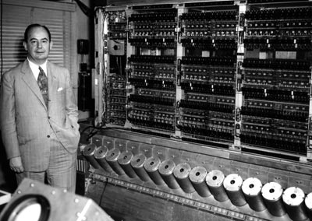
Von Neumann Architecture
1945, John Von Neumann prepared a long document outlining a new approach in which programs were coded, along with the data they manipulated– both data and program stored in memory
“Father of modern computers”

Slide 23
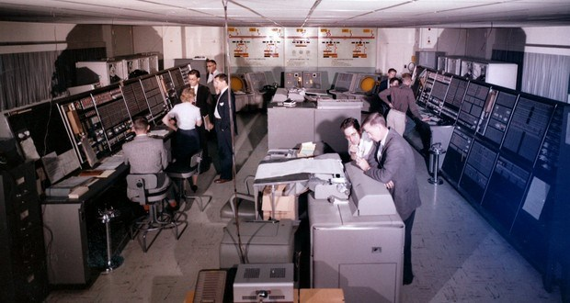
The AN/FSQ-7 Computer “SAGE”
Completed in 1955 by the US Air Force as part of the “SAGE” air defense computer system
The computer itself occupied an acre of floor space.
https://factrepublic.com/facts/3409/

Slide 24
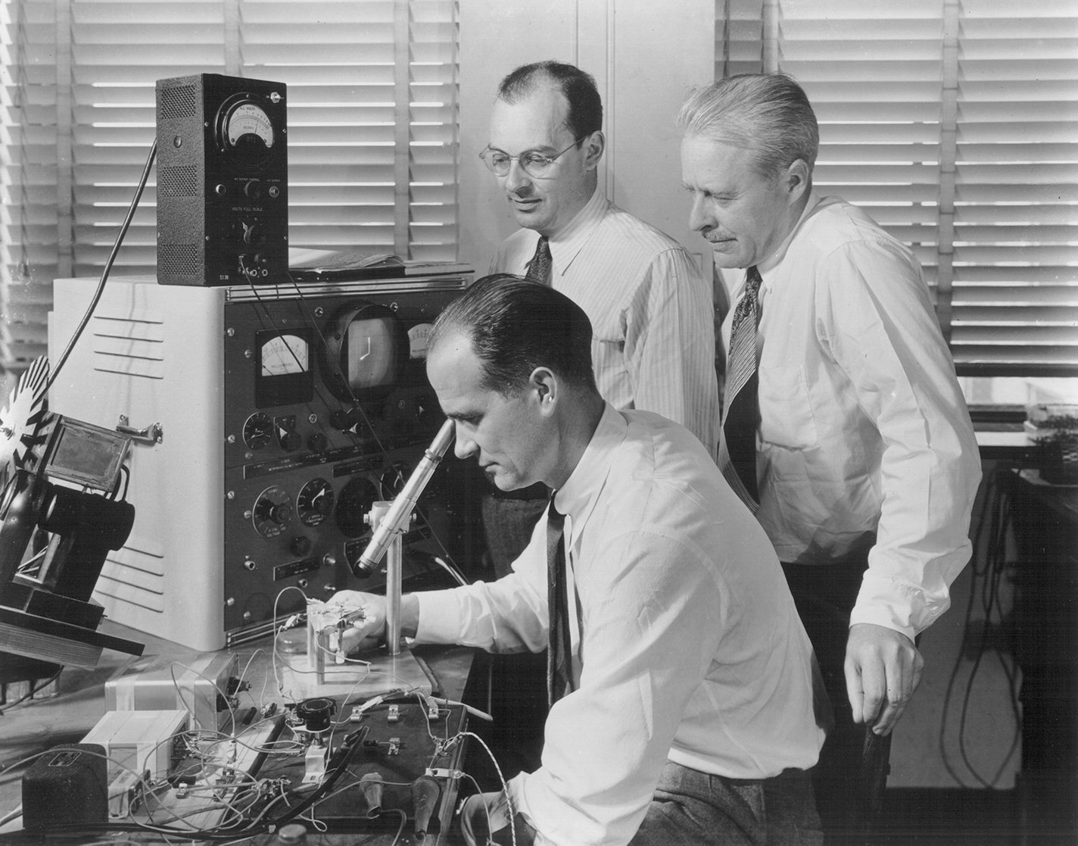
The Invention of the Transistor
In 1947, Bell Laboratory scientists John Bardeen, Walter Brattain, and William Shockley invented the transistor, a small semiconductor device
Started a whole new era of computing
They won the 1956 Nobel Prize in Physics
William Shockley moved to “Silicone Valley”, founding Shockley Semiconductor, whose employees later founded Fairchild Semiconductors, whose employees later founded Intel - the world’s largest computer chip maker today.
John Bardeen, Walter Brattain, and William Shockley

Slide 25
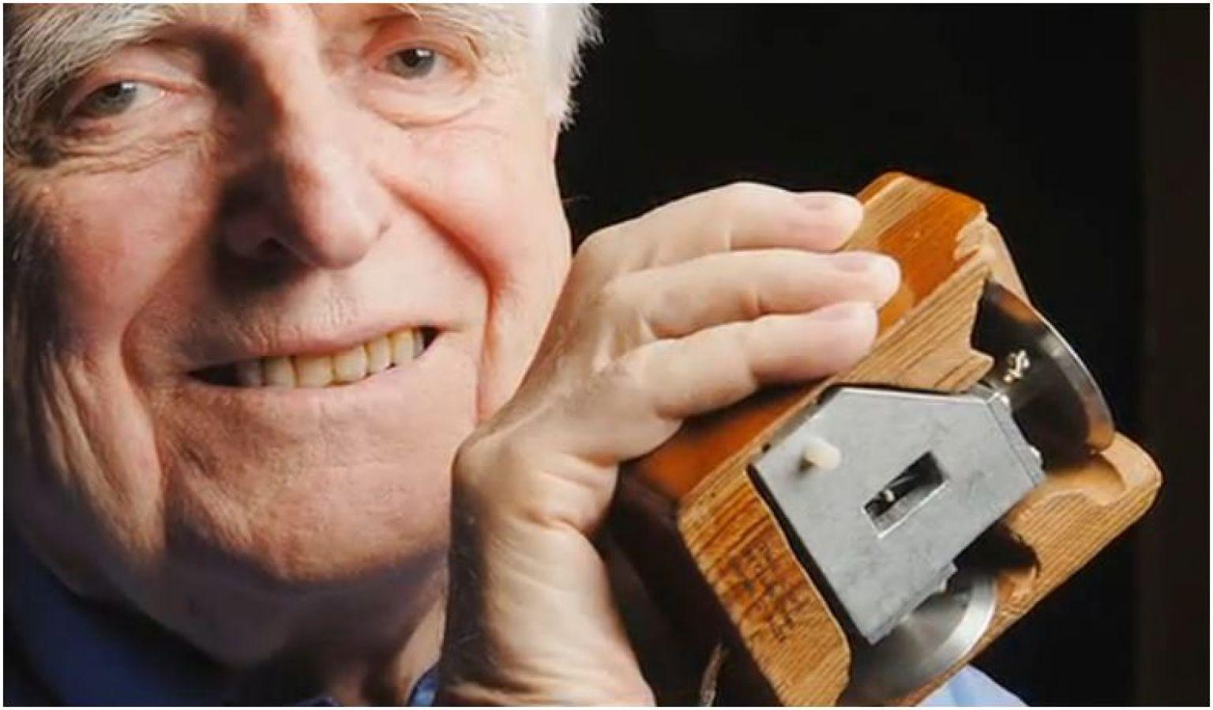
Douglas Engelbart
Invented the computer mouse, developed the basic graphical user interface (GUI), groupware, the multiple-window display, and hypermedia (the linking of texts, images, video, and sound files within a single document), joysticks, light pens, and track balls
Engelbart’s dream was to use computers to connect individuals in a network that would allow them to share and update information in “real time.”
in 1967 Engelbart’s laboratory became the second site on the Advanced Research Projects Agency Network (ARPANET), the primary precursor to the Internet.
Douglas Engelbart with mouse

Slide 26
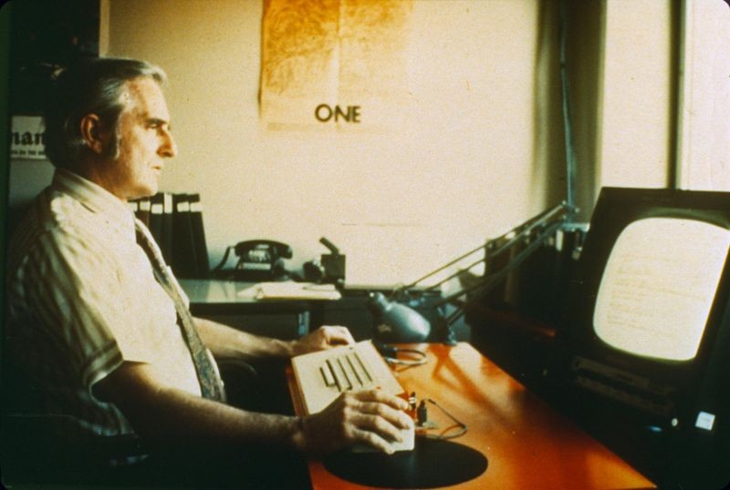
ARPANET
1968, The Advanced Research Projects Agency Network (ARPANET) was created
The first wide-area packet-switching network with distributed control and one of the first networks to implement the TCP/IP protocol suite. Both technologies became the technical foundation of the Internet.
Douglas Engelbart at NLS workstation

Slide 27
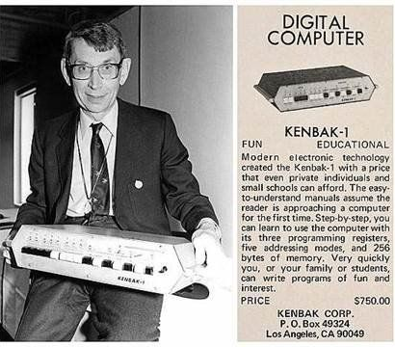
First Personal Computer
1971, John Blankenbaker created the world’s first commercially available personal computer (5 years before apple 1)
"I came into a little money and decided it was time to build a small computer that could be afforded by everyone" – Blankenbaker
Sold for $750 (about $4,400 in 2015)
"My failure was in marketing, but the machine was a success in its limited way."
John Blankenbaker made the prototype of the Kenbak-1 personal computer in his garage

Slide 28
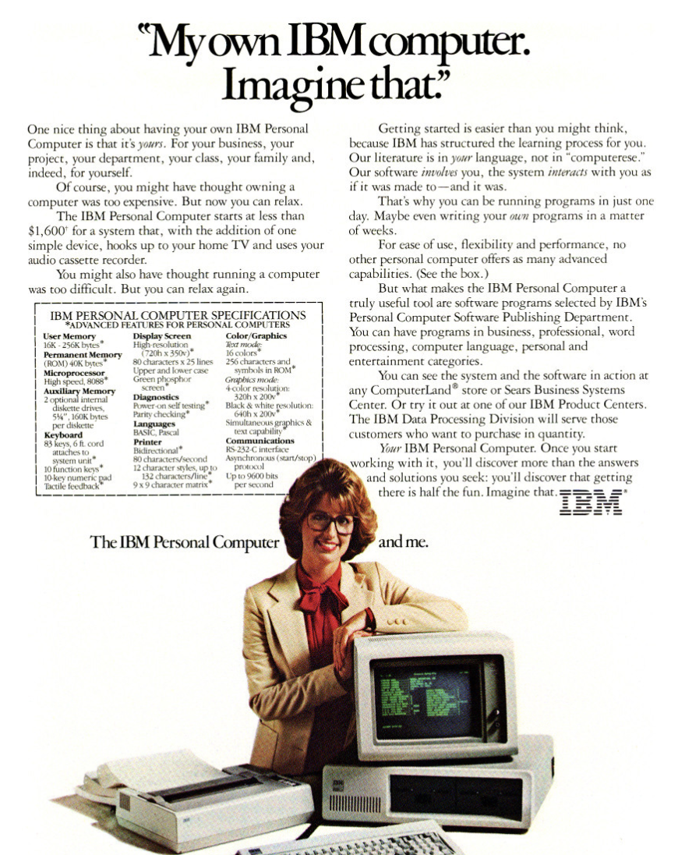
IBM’s First MS-DOS Computer
August 12, 1981 IBM introduced the IBM PC
16KB of RAM and a single floppy drive
Ran MS-DOS, operating system for personal computers mostly developed by Microsoft

Slide 29
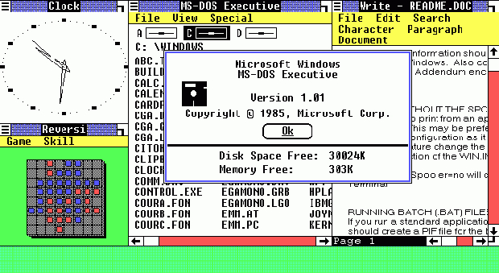
Windows 1.0 is Released
Released November 1, 1984
he first desktop environment developed and made by Microsoft
Built on top of Microsoft DOS.
Did not allow windows to overlap each other. The device has 256 KB of memory storage.

Slide 30
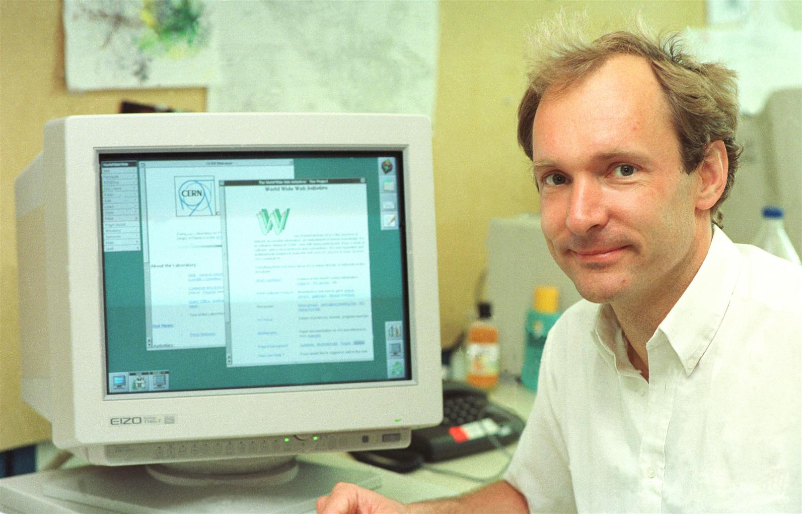
The World Wide Web
Invented by British scientist Tim Berners-Lee in 1989 while working at CERN
Originally developed to meet the demand for automated information-sharing between scientists in universities and institutes around the world
First EVER website: info.cern.ch

Slide 31
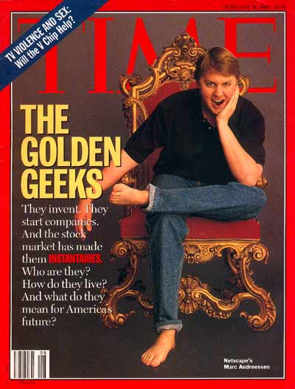
Mosaic (Netscape)
In 1993 21-year-old Marc Andreessen created Mosaic (later Netscape) the first popular, user-friendly web browser
He wanted to democratize the world wide web and make information accessible to anyone, anywhere, at any time
Cover Credit: SAM JONES

Slide 32
Present Day
Computing keeps advancing at a rapid rate
New amazing technologies, programs, applications, etc. are created everyday
Many groups of people have been very underrepresented in this world so let’s talk about it and think about how to change it(:

Slide 34
Sources:
https://www.energy.gov/nnsa/articles/then-and-now-computing-power
https://www.ibm.com/ibm/history/ibm100/us/en/icons/founded/
https://www.britannica.com/technology/Harvard-Mark-I
https://spectrum.ieee.org/tech-talk/tech-history/dawn-of-electronics/untold-history-of-ai-invisible-woman-programmed-americas-first-electronic-computer
https://www.ibm.com/ibm/history/ibm100/us/en/icons/sage/breakthroughs/
https://spectrum.ieee.org/computing/hardware/the-ghosts-of-computers-past
https://www.smithsonianmag.com/innovation/douglas-engelbart-invented-future-180967498/
https://www.bbc.com/news/business-34639183
https://en.wikipedia.org/wiki/MS-DOS
https://microsoft.fandom.com/wiki/Windows_1.0
https://home.cern/science/computing/birth-web
http://content.time.com/time/covers/0,16641,19960219,00.html

